Slide 1


#88,89, SSN Square, Peelamedu Pudhur,Coimbatore-641004
Notes:
88,89,SSN Square,Peelamedu Pudhur,Coimbatore-641004

Slide 2
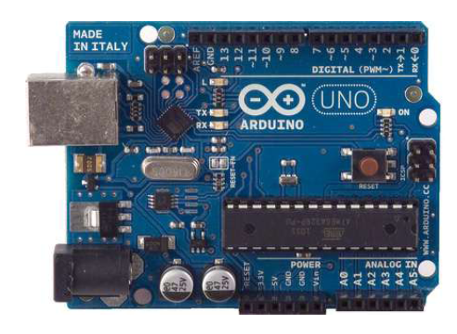
Arduino Microcontroller
Introduction
open-source
#88,89, SSN Square, Peelamedu Pudhur,Coimbatore-641004
Slide <number>

Slide 3
Arduino Microcontroller- 16 bit
ATmega328 microcontroller operating at 5 V with 2Kb of RAM, 32 Kb of flash memory for storing programs and 1 Kb of EEPROM.
The clock speed is 16 MHz
The board has 14 digital I/O pins and 6 analog input pins
#88,89, SSN Square, Peelamedu Pudhur,Coimbatore-641004
Slide <number>

Slide 4

Arduino Microcontroller- 16 bit
USB connection between board and computer
The Arduino programming language is a simplified version of C
#88,89, SSN Square, Peelamedu Pudhur,Coimbatore-641004
Slide <number>

Slide 5
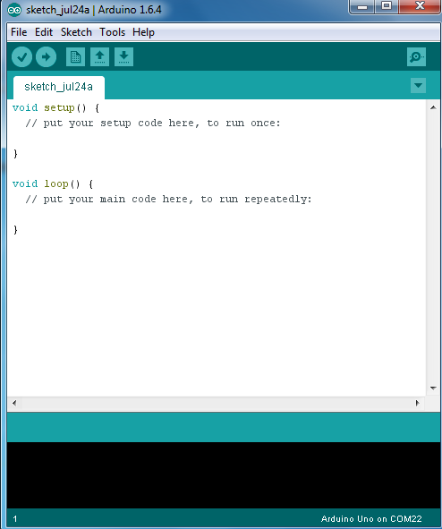
Arduino Microcontroller
#88,89, SSN Square, Peelamedu Pudhur,Coimbatore-641004
Slide <number>

Slide 6
Interfacing
LED
SWITCH
Buzzer
ADC
ADC WITH LED
TEMP SENSOR
PIR SENSOR
DC MOTOR
ULTROSONIC SENSOR
LCD
STEPPER MOTOR
#88,89, SSN Square, Peelamedu Pudhur,Coimbatore-641004
Slide <number>

Slide 7
Thank You!
Contact Info:
Enthu Technology Solutions India Pvt Ltd,
88,89,SSN Square, Peelamedu Pudhur, Near PSG Tech,
Coimbatore-641004
0422-2417197
+919940707197 info@enthutech.in www.enthutech.in
#88,89, SSN Square, Peelamedu Pudhur,Coimbatore-641004
Slide <number>

